Slide 1
New targets in small cell lung cancer, a “target orphan” disease
Gregory J. Riely
Memorial Sloan Kettering Cancer Center, New York, USA

Slide 2
DISCLOSURES
I have been a compensated consultant to Genentech/Roche
I have received travel expenses from Merck
Memorial Sloan Kettering receives research funding from Roche, Takeda, Novartis, and Pfizer for my research

Slide 3
Agenda
What do we know about the biology of small cell lung cancer?
PARP Inhibitors
Lurbinectidin
Rovalptuzumab

Slide 4
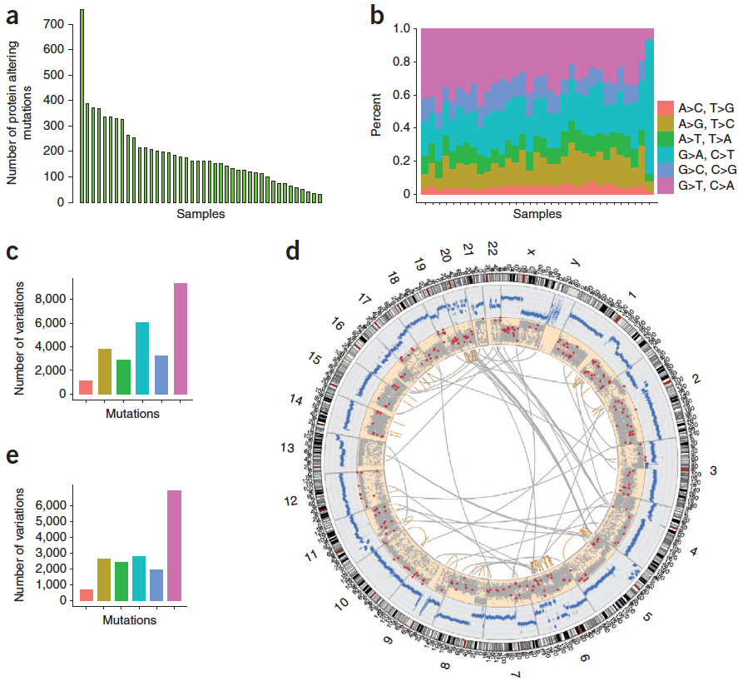
SCLC: major structural genomic aberrations
Rudin et al., Nat Genet 2012
Notes:
The first comprehensive genomic analysis of SCLC was published in 2012 by Charlies group while he was at Hopkins. Roman Thomas’s group followed in 2012 and then a tour de force 2015 nature paper by Julie George.
These studies defined the genomic landscape of SCLC, with near universal inactivation of tumor suppressorsTP53 and RB1, and demonstrated the extreme complexity of the SCLC genome with an average of 175 non-synonymous mutations per tumor.
This is a circos plot from the whole genome sequencing of human SCLC from the initial nature genetics paper showing the high number of copy number alterations, mutations and inter and intra chromosomal rearrangements.
This high mutational load would substantially compromise any attempt at analyzing determinants of acquired resistance between two unrelated or unlinked tumors for patients with SCLC. Given the amount of noise and heterogeneity between individuals treated with first line systemic therapy - identifying determinants of acquired chemotherapy resistance would be akin to finding a needle in a haystack.

Slide 5
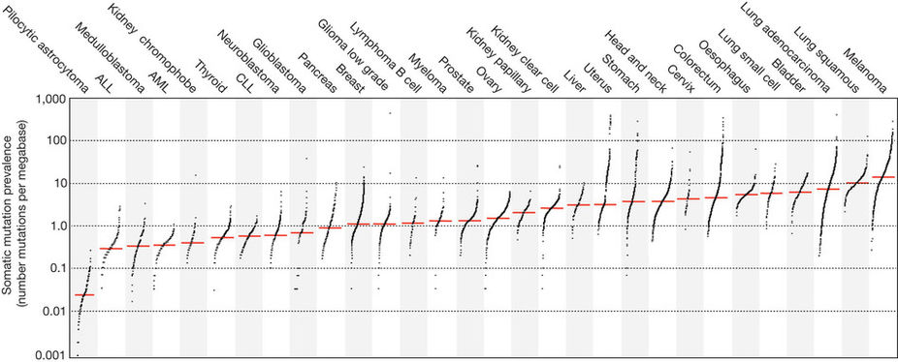
Somatic Mutation Rate by Tumor Type
Alexandrov et al, Nature 2013

Slide 6
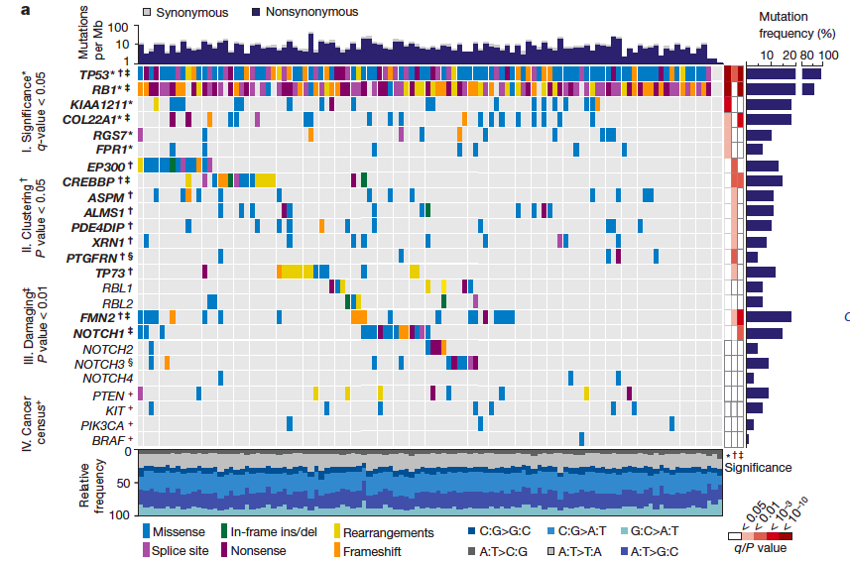
Molecular Aberrations in Small Cell Lung Cancer
Universal Loss of TP53/RB1
Relatively frequent events in Notch pathway
George et al, Nature 2015

Slide 7
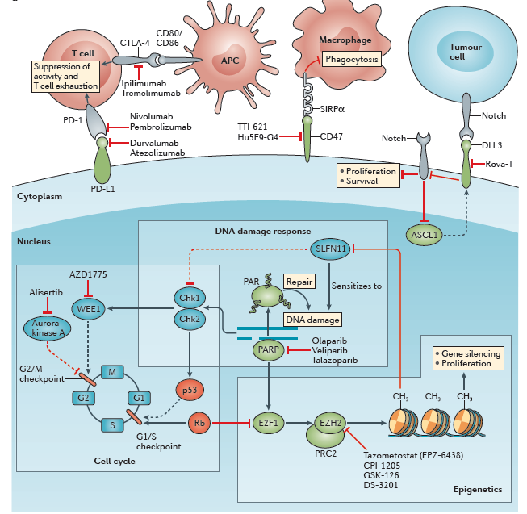
Novel therapeutic targets in SCLC
Sabari et al., Nat Rev Oncol 2017.
Notes:
From the common targets such as PD-L1 and CTLA4 inhibition which in early phase trials has shown a response rate of 25% independent of PD-L1 status, CD47 macrophage don’t-eat me signal – I wrote a phase I protocol that is now open at MSK testing a trillium compound TTI-621, DLL3 and the drug antibody conjugate Rova-T which just completed the phase II, phase III studies are ongoing, PARP inhibition with ongoing studies Lauren Byers MD Anderson and Anna Farago MGH, and cell cycle checkpoint inhibitors based on early clinical work out of Caroline Dive’s lab in Manchester we’re enrolling patients in a phase I study assessing safety of a WEE1 inhibitor AZD1775 in combination with Olaparib is ongoing.
This talk will focus on an epigenetic targeted mechanism – via inhibition of EZH2 leading to increased chemotherapy sensitivity via the SFLN11 axis.

Slide 8
Novel therapeutic targets in SCLC
Sabari et al., Nat Rev Oncol 2017.
Notes:
From the common targets such as PD-L1 and CTLA4 inhibition which in early phase trials has shown a response rate of 25% independent of PD-L1 status, CD47 macrophage don’t-eat me signal – I wrote a phase I protocol that is now open at MSK testing a trillium compound TTI-621, DLL3 and the drug antibody conjugate Rova-T which just completed the phase II, phase III studies are ongoing, PARP inhibition with ongoing studies Lauren Byers MD Anderson and Anna Farago MGH, and cell cycle checkpoint inhibitors based on early clinical work out of Caroline Dive’s lab in Manchester we’re enrolling patients in a phase I study assessing safety of a WEE1 inhibitor AZD1775 in combination with Olaparib is ongoing.
This talk will focus on an epigenetic targeted mechanism – via inhibition of EZH2 leading to increased chemotherapy sensitivity via the SFLN11 axis.

Slide 9
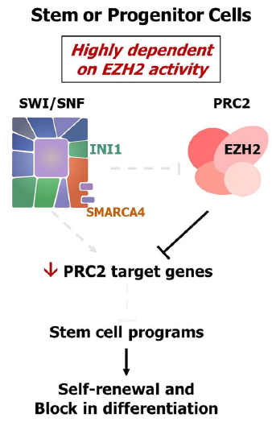
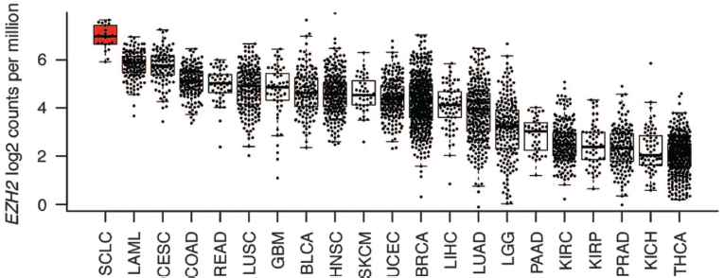
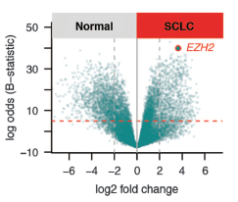
EZH2 and SCLC
EZH2 places the repressive chromatin H3K27^{me3} modification
Associated with gene silencing
Poirier et al., Oncogene 2015
Notes:
Post-translational modifications of histones play an important role in controlling the fidelity of cellular gene transcription patterns. Methylation of histone lysine and arginine residues, catalyzed by histone methyltransferases (HMTs), is a particularly important determinant of gene accessibility and transcription. Genetic alterations in a number of HMTs have been implicated in oncogenesis. Enhancer of Zeste homolog 2 (EZH2) catalyzes trimethylation of lysine 27 of histone H3 (H3K27), a suppressive mark associated with local chromatin condensation and gene silencing.
Aberrant EZH2 activity has been implicated in oncogenesis in some tumor types, and changes in other proteins can lead to an oncogenic dependency on EZH2 activity, specifically those affecting the SWItch/Sucrose Non-Fermentable (SWI/SNF) chromatin remodeling complex. Inhibition of EZH2 activity by either knock-down or small molecule inhibition induces tumor cell death and durable tumor regression in preclinical models. EZH2 is highly expressed in SCLC and upregulation of EZH2 drives silencing of SLFN11. SLFN11 silencing is reversible in SCLC with EZH2 inhibition. In vivo and in vitro preclinical studies suggest that EZH2 inhibition rescues silencing of SLFN11 leading to treatment response in previously chemotherapy resistant models.

Slide 10
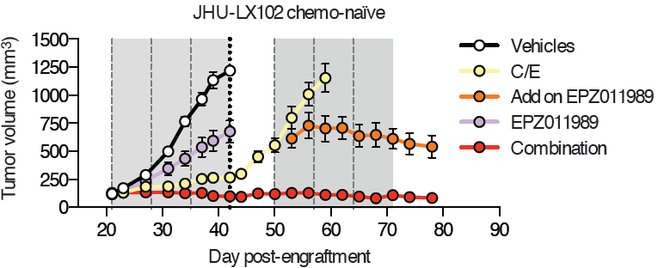
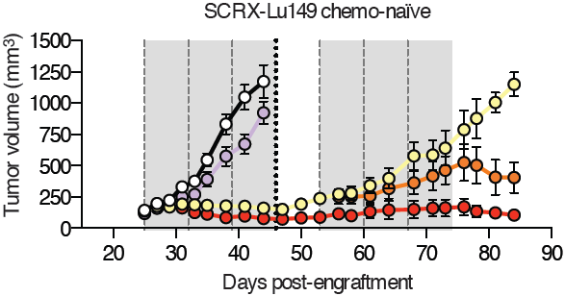
EZH2 inhibition can prevent acquired resistance to 1st line therapy in chemonaïve SCLC
LX102 chemonaïve
LU149 chemonaïve
Notes:
These are in vivo experiments of two chemonaive PDX-models, LX102 and LU149. The x axis represents time in days and the y axis represents tumor volume.
The black line represents the vehicle, untreated, and you can see rapid tumor growth.
The purple line are mice treated with single agent EPZ-11989, a preclinical EZH2 inhibitor made by epizyme, and you can see there is only minimal single agent activity.
The yellow line represents the combination of cisplatin and etoposide and you can see initial response followed by chemotherapy resistance and tumor breakthrough.
The red line represents combination chemotherapy and EZh2 inhibitor which shows the prevention of chemotherapy resistance. What is really exciting is that if you take a chemotherapy resistant animal and add the EZH2 inhibitor, shown in orange, we are able to re-sentisitize to chemotherapy and show tumor regression or stabilization in growth.

Slide 11
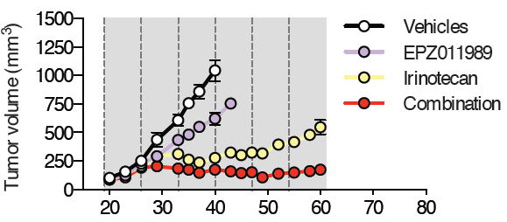
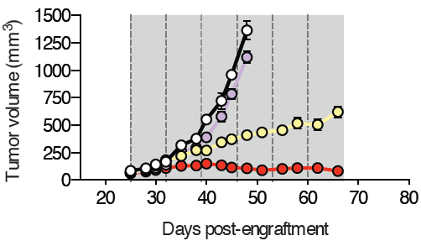
EZH2 inhibition can markedly improve 2nd line therapy in chemoresistant SCLC
LX102 chemoresistant
LU149 chemoresistant
Notes:
This is the same experiment shown on the last slide, however now with chemoresistant PDX-models. EZH2 inhbition in combination with irinotecan can markedly improve second line therapy in chemoresistant PDX models.

Slide 12
EZH2 Inhbitors in development
Compound | Company | MOA | Trials
EPZ-6438 (Tazometostat) | Epizyme | S-adenosyl methionine (SAM) competitive inhibitor EZH2 | NCT02601950 NCT01897571 NCT02860286 NCT02601937
CPI-1205 | Constellation | SAM competitive inhibitor EZH2 &PRC2 | NCT02395601
GSK-126 | Glaxo-SmithKline | SAM competitive inhibitor EZH2 & PRC2 | NCT02082977
DS-3201 | Daiichi Sankyo | histone lysine competitive inhibitor of methyltransferases EZH1 and EZH2 | NCT02732275 NCT03110354

Slide 13
Novel therapeutic targets in SCLC
Sabari et al., Nat Rev Oncol 2017.
Notes:
From the common targets such as PD-L1 and CTLA4 inhibition which in early phase trials has shown a response rate of 25% independent of PD-L1 status, CD47 macrophage don’t-eat me signal – I wrote a phase I protocol that is now open at MSK testing a trillium compound TTI-621, DLL3 and the drug antibody conjugate Rova-T which just completed the phase II, phase III studies are ongoing, PARP inhibition with ongoing studies Lauren Byers MD Anderson and Anna Farago MGH, and cell cycle checkpoint inhibitors based on early clinical work out of Caroline Dive’s lab in Manchester we’re enrolling patients in a phase I study assessing safety of a WEE1 inhibitor AZD1775 in combination with Olaparib is ongoing.
This talk will focus on an epigenetic targeted mechanism – via inhibition of EZH2 leading to increased chemotherapy sensitivity via the SFLN11 axis.

Slide 14
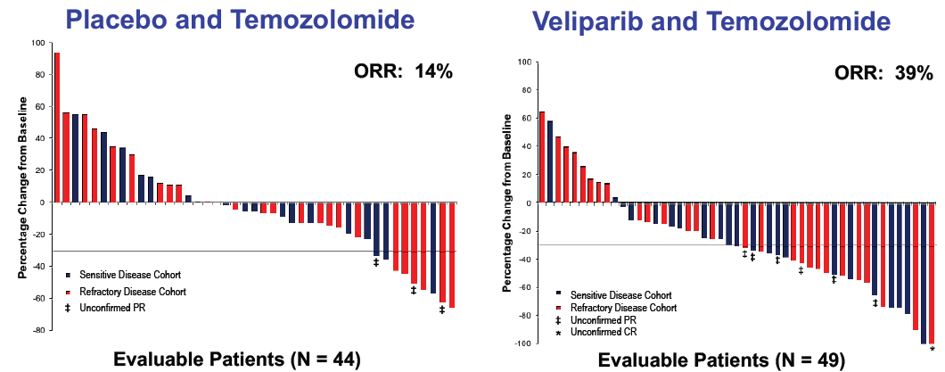
PARPi (veliparib) plus DNA damage (temozolomide)
ASCO 2016 (abstr 8512)

Slide 15
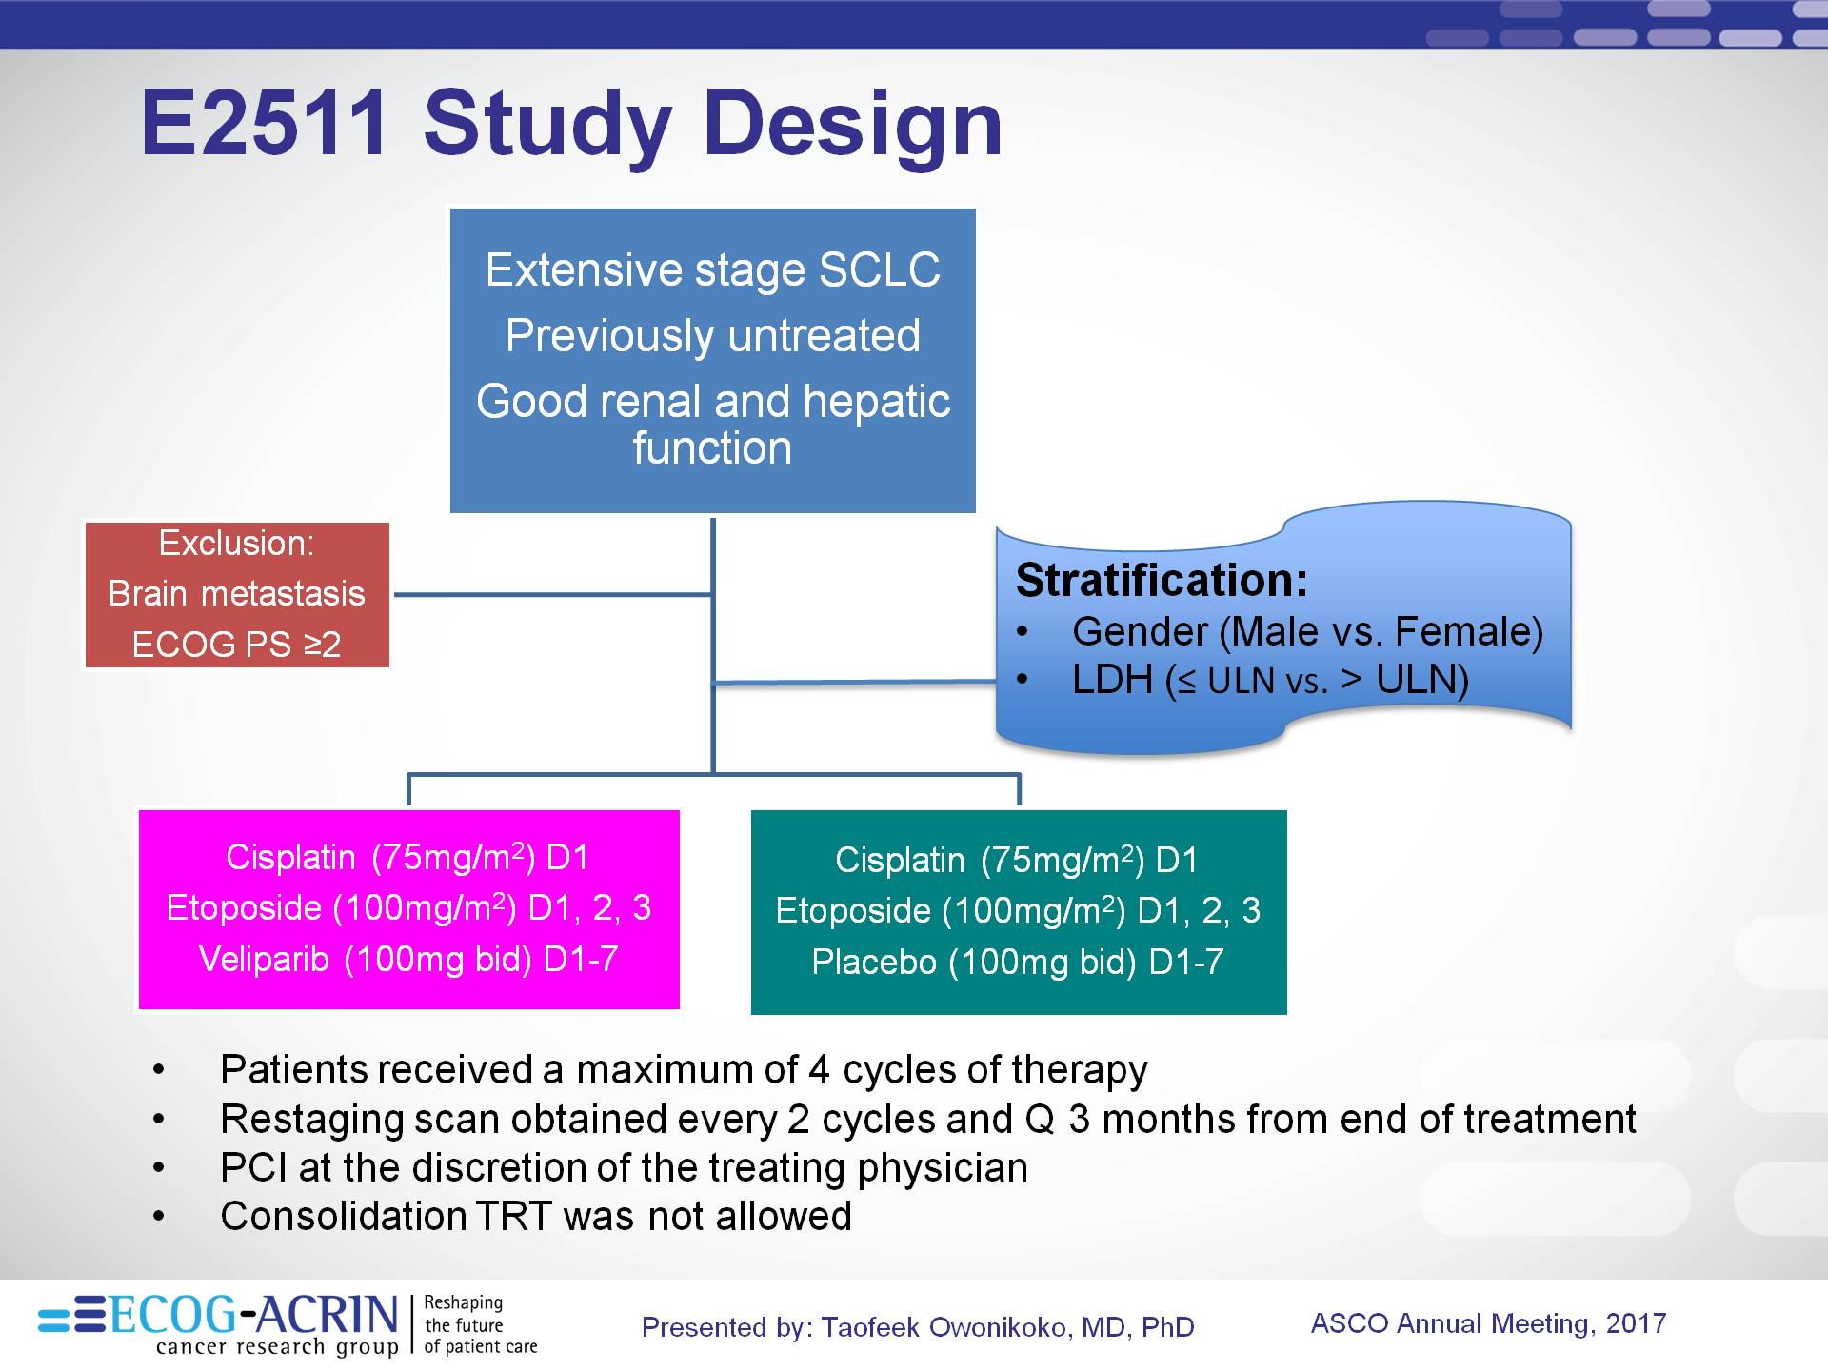
Adding PARP Inhibitor to First Line Chemotherapy

Slide 16
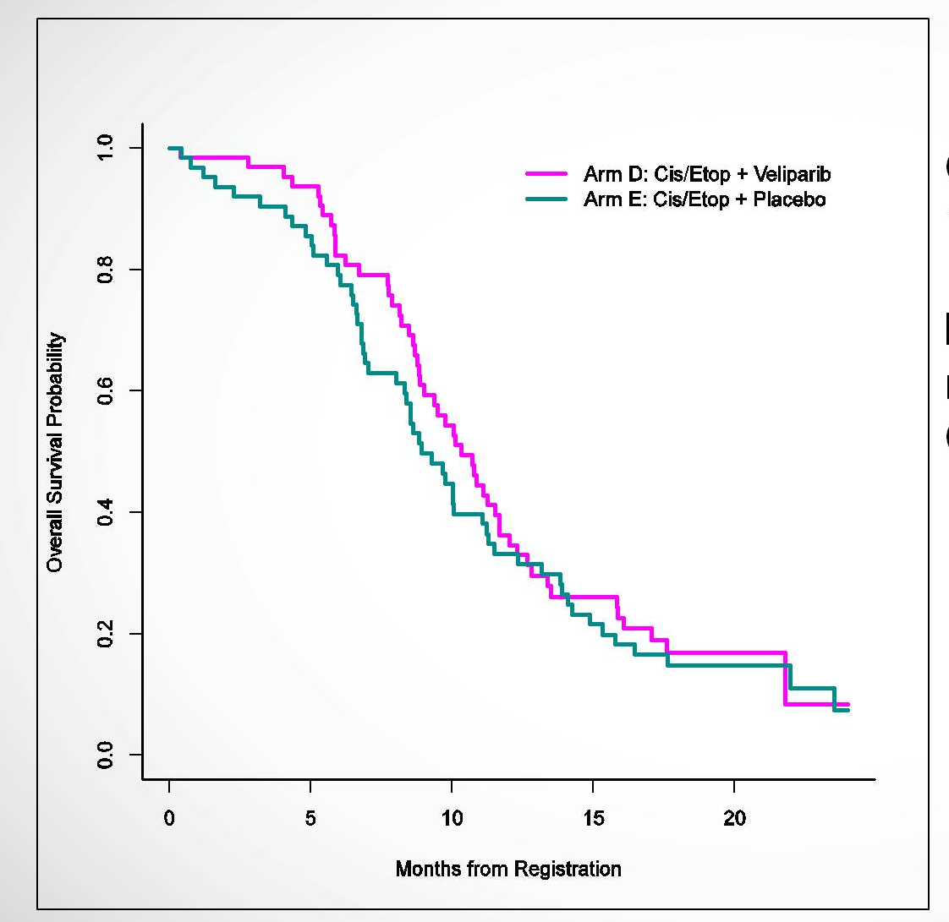
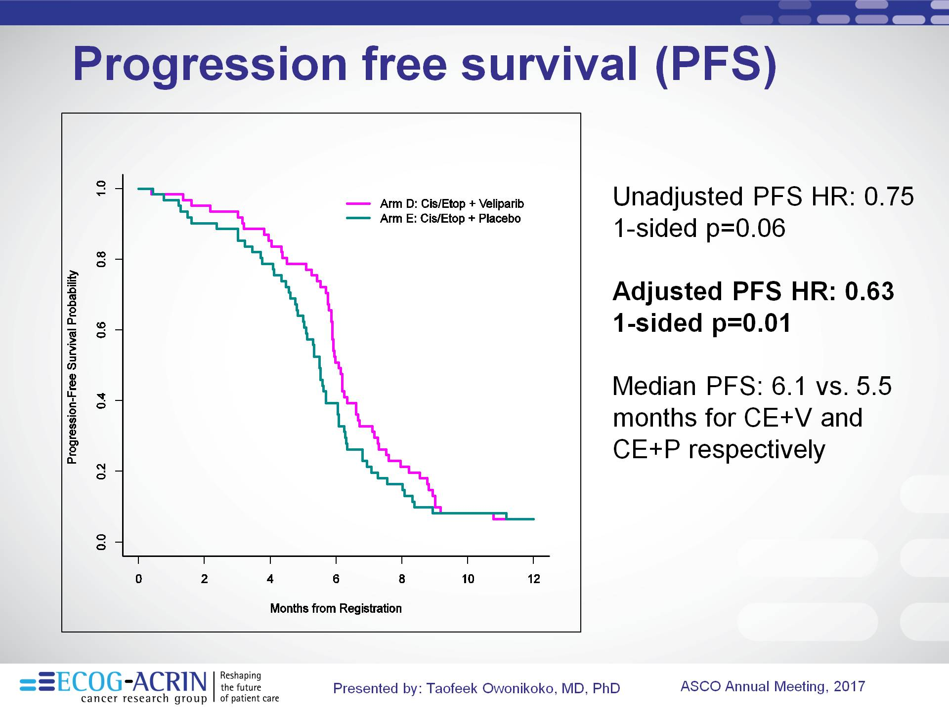
Adding PARP Inhibitor to First Line Chemotherapy
PFS
OS
Adjusted PFS HR 0.63 (p=0.01)
OS HR 0.83 (p=0.17)
Owonikoko et al, ASCO 2017

Slide 17
Novel therapeutic targets in SCLC
Sabari et al., Nat Rev Oncol 2017.
Notes:
From the common targets such as PD-L1 and CTLA4 inhibition which in early phase trials has shown a response rate of 25% independent of PD-L1 status, CD47 macrophage don’t-eat me signal – I wrote a phase I protocol that is now open at MSK testing a trillium compound TTI-621, DLL3 and the drug antibody conjugate Rova-T which just completed the phase II, phase III studies are ongoing, PARP inhibition with ongoing studies Lauren Byers MD Anderson and Anna Farago MGH, and cell cycle checkpoint inhibitors based on early clinical work out of Caroline Dive’s lab in Manchester we’re enrolling patients in a phase I study assessing safety of a WEE1 inhibitor AZD1775 in combination with Olaparib is ongoing.
This talk will focus on an epigenetic targeted mechanism – via inhibition of EZH2 leading to increased chemotherapy sensitivity via the SFLN11 axis.

Slide 18
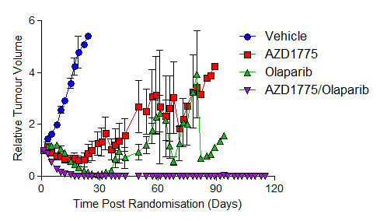
Cell cycle vulnerabilities
Essentially universal loss of TP53 and RB1
Loss of multiple cell cycle checkpoints
Wee1 inhibition further compromises DNA damage repair
PARP inhibitor + Wee1 inhibitor
CDX model
Caroline Dive and colleagues

Slide 19
Novel therapeutic targets in SCLC
Sabari et al., Nat Rev Oncol 2017.
Notes:
From the common targets such as PD-L1 and CTLA4 inhibition which in early phase trials has shown a response rate of 25% independent of PD-L1 status, CD47 macrophage don’t-eat me signal – I wrote a phase I protocol that is now open at MSK testing a trillium compound TTI-621, DLL3 and the drug antibody conjugate Rova-T which just completed the phase II, phase III studies are ongoing, PARP inhibition with ongoing studies Lauren Byers MD Anderson and Anna Farago MGH, and cell cycle checkpoint inhibitors based on early clinical work out of Caroline Dive’s lab in Manchester we’re enrolling patients in a phase I study assessing safety of a WEE1 inhibitor AZD1775 in combination with Olaparib is ongoing.
This talk will focus on an epigenetic targeted mechanism – via inhibition of EZH2 leading to increased chemotherapy sensitivity via the SFLN11 axis.

Slide 20
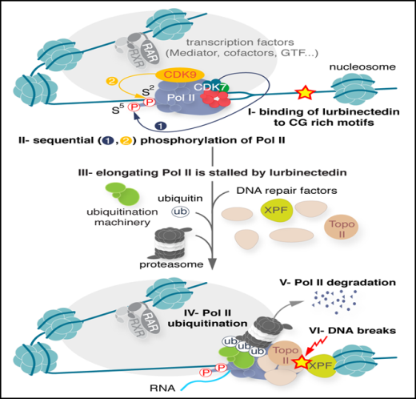
Lurbinectedin
inhibits activated transcription,
induces DNA double-strand breaks
modulates tumor microenvironment.
Olmedo et al, ESMO 2017

Slide 21
Lurbinectedin Single-Agent Activity in Small Cell
Response Rate – 36%
Olmedo et al, ESMO 2017

Slide 22
Lurbinectedin Combined with Doxorubicin in Small Cell
Response Rate 37%-67%
Olmedo et al, ESMO 2017

Slide 23
Ongoing Trial of Lurbinectidin + Doxorubicin “ATLANTIS”
Lurbinectidin
⁺
^{Doxorubicin}
Patients
Extensive Stage Small Cell Lung Cancer
Progressed after 1st line platinum-doublet
CAV
^{or}
^{Topotecan}
Primary Endpoints: PFS/OS
n=600

Slide 24
Novel therapeutic targets in SCLC
Sabari et al., Nat Rev Oncol 2017.
Notes:
From the common targets such as PD-L1 and CTLA4 inhibition which in early phase trials has shown a response rate of 25% independent of PD-L1 status, CD47 macrophage don’t-eat me signal – I wrote a phase I protocol that is now open at MSK testing a trillium compound TTI-621, DLL3 and the drug antibody conjugate Rova-T which just completed the phase II, phase III studies are ongoing, PARP inhibition with ongoing studies Lauren Byers MD Anderson and Anna Farago MGH, and cell cycle checkpoint inhibitors based on early clinical work out of Caroline Dive’s lab in Manchester we’re enrolling patients in a phase I study assessing safety of a WEE1 inhibitor AZD1775 in combination with Olaparib is ongoing.
This talk will focus on an epigenetic targeted mechanism – via inhibition of EZH2 leading to increased chemotherapy sensitivity via the SFLN11 axis.

Slide 25
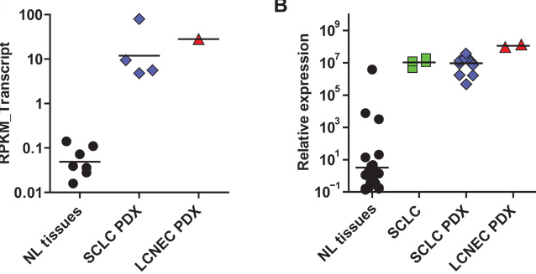
Targeting DLL3 in Small Cell Lung Cancer
DLL3 is a notch-1 ligand
DLL3 inhibits notch receptor
activation
high expression in most
small cell lung cancers
expression of DLL3 is rare in
normal tissues
Saunders et al., (2015) Science Transl Med

Slide 26
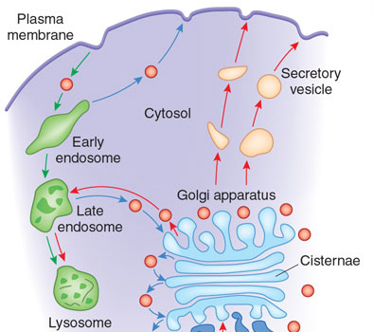
Rovalpituzumab Tesirine (Rova-T) targeting aberrant DLL3
= DLL3
Rova-T (SC16LD6.5)
Antibody Drug Conjugate with
Antibody to DLL3 linked to
Pyrrolobenzopdiazepine
Saunders et al., (2015) Science Transl Med

Slide 27
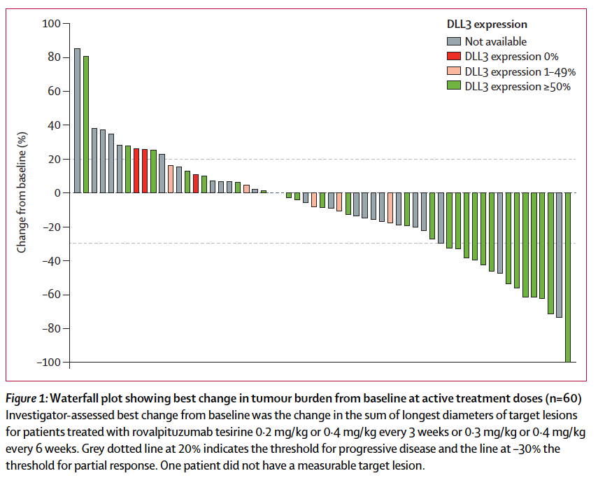
Radiographic responses to Rova-T by DLL3 status
11/60 (18%) had a confirmed objective response,
10/26 (38%) with high DLL3 expression (> 50% tumor cells)
Rudin et al, Lancet Oncology 2017

Slide 28
Rovalpituzumab Tesirine after Two Prior Therapies for SCLC “TRINITY”
Patients
Extensive Stage Small Cell Lung Cancer
Two prior therapies
DLL3 ≥ 1% (central assay)
PS 0-2
Rovalpituzumab
Primary endpoints: RR, OS
clinicaltrials.gov

Slide 29
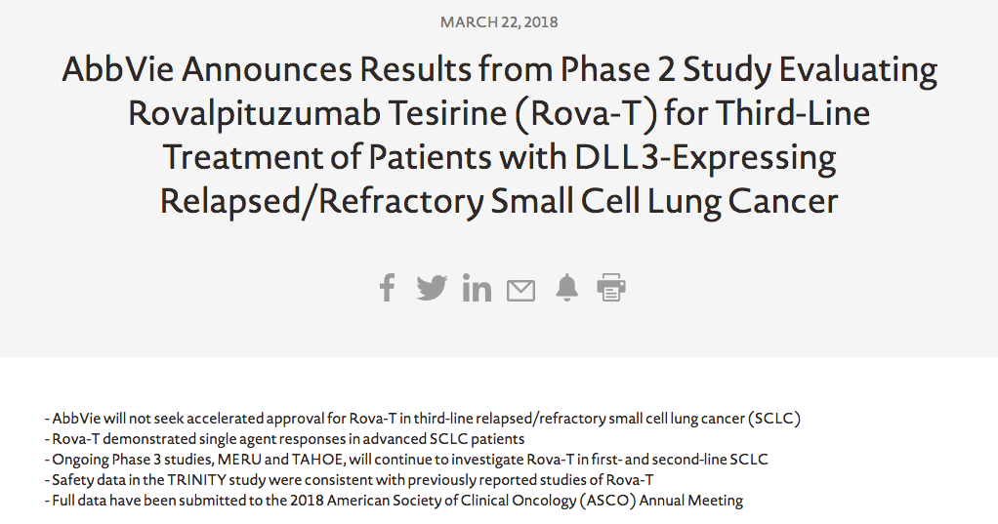

Slide 30
Rovalpituzumab Tesirine as Maintenance Therapy “MERU”
Patients
Extensive Stage Small Cell Lung Cancer
Must have had PR/SD after 4 cycles of platin-etoposide chemotherapy
Begin maintenance 3-9 weeks after last chemo
Rova-T
Placebo
Primary Endpoints: PFS/OS
n=740

Slide 31
Rova-T in Second Line “TAHOE”
Patients
Extensive Stage Small Cell Lung Cancer
Progressed after prior platin-doublet
High DLL3 (>75% of cells stain for DLL3)
Rova-T
Topotecan
Primary Endpoint: RR/OS
n=411

Slide 32

A Phase 1/2 Study on the Safety of Rovalpituzumab Tesirine Administered in Combination with Nivolumab or Nivolumab and Ipilimumab for Adults with Extensive-Stage Small Cell Lung Cancer

Slide 33
Conclusions
Genomic analyses have identified a number of important targets, many of which are worthy of investigation with drugs available today
There are no targeted therapies in clinic today with “home run” single-agent response rates.
We look forward to the results of clinical trials seeking to improve upon topotecan

